Slide 1
Advanced/Special Permissions : SUID & GUID
Snehal Deshmukh

Slide 2
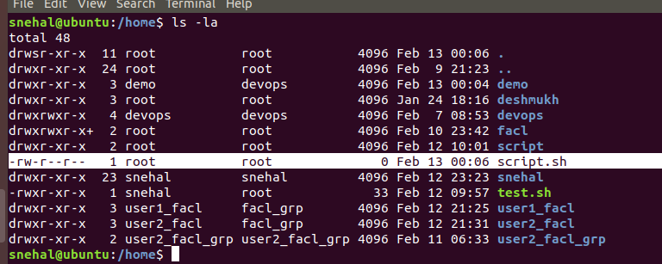
We create a file script.sh & try to excute in another user it gives you error perm.denied :

Slide 3
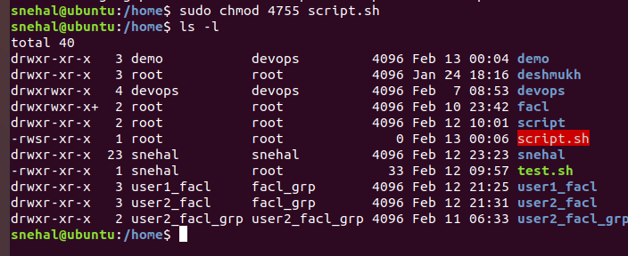
So we set the SUID bit on it. To do this using the numeric method :

Slide 4
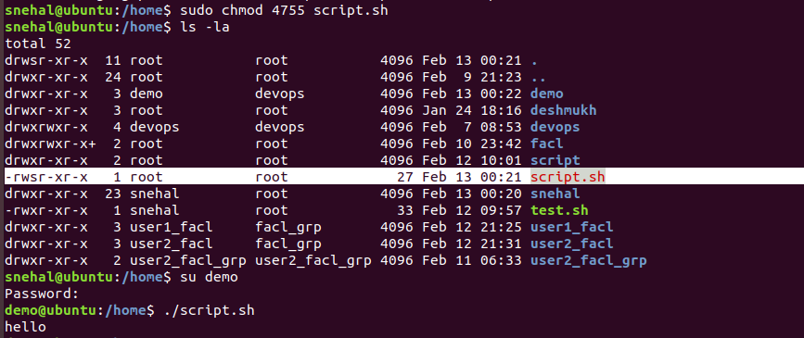
When you set the file permissions to 4755 (which is equivalent to rwxr-sr-x), it means that the owner of the file has read, write, and execute permissions, while others (that is, users who are not the owner and do not belong to the same group as the owner) have only execute permissions. This means that other users will not be able to write to the file.

Slide 5
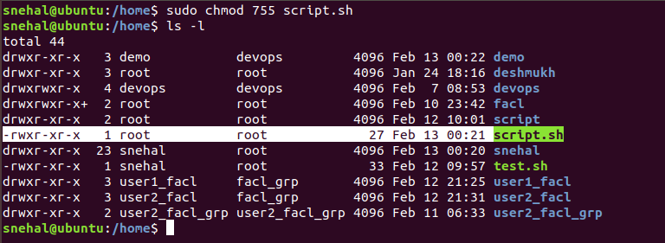
chmod 755 script.sh that is, owner has read, write, and execute permissions, while group and others have read and execute permissions only). This effectively removes the SUID bit from the file.

Slide 6
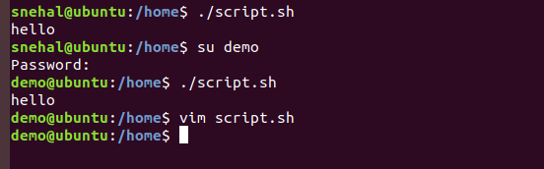
The file will run with the permissions of its owner

Slide 7
Before Set SUID | After Set SUID
The file will run with the permissions of the user who executes it. | The file will run with the permissions of its owner, regardless of who executes it.
The file will run with the permissions of its owner | The file will run with the permissions of its owner, regardless of who executes it.
generally considered a more secure configuration, as it reduces the attack surface of the file and makes it less likely to be used for malicious purposes. | setting the SUID bit on a file can be a security risk, as it allows anyone who can run the file to execute it with elevated privileges.

Slide 8
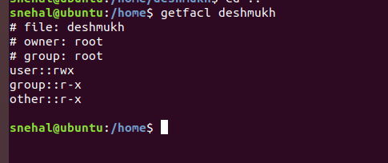
SGID- check directory info

Slide 9
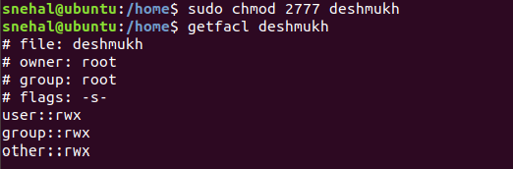
sudo chmod 2777 deshmukh : sets the SGID bit in the group permissions, which allows new subdirectories created within the directory to inherit the group ownership of the parent directory

Slide 10
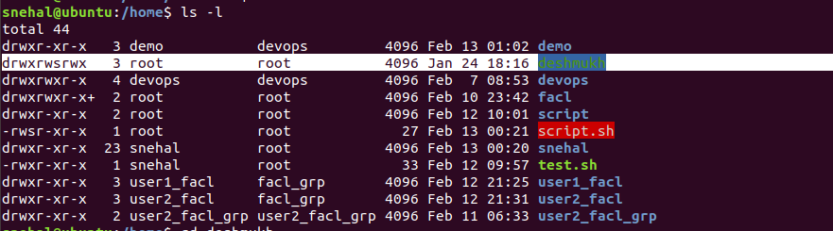

Slide 11
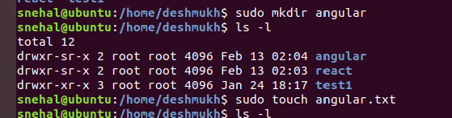
Additionally, the 7 in the group and others permissions fields grants full permissions (read, write, and execute) to the group and others.

